Slide 1
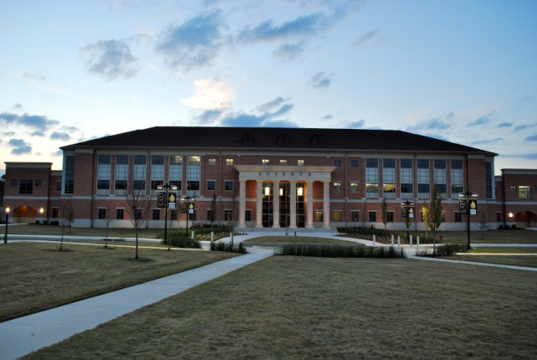
Southern Arkansas University
Natural Resource Research Center
Energy park and learning center
Striving to become a leader in energy
and Industry

Slide 2
Striving to become a leader in energy
and Industry by:
Providing energy solutions to promote economic development
Providing research and training facilities for faculty and students in the STEM and business disciplines
Providing partnerships between SAU and industry to further
energy and mining activity (industry & academic model advantage)
Making SAU a hub for economic development in Southern Arkansas
NRRC will partner with small business development, economic development to be a one stop small business incubator
Applied research and
training, target resources
Provide expertise in analytical
chemistry & Petroleum
research

Slide 3
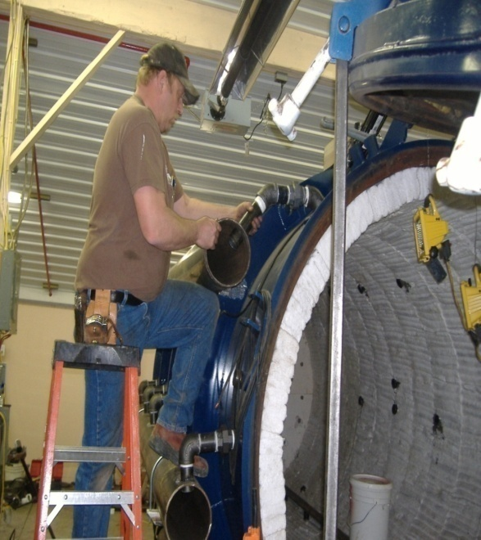
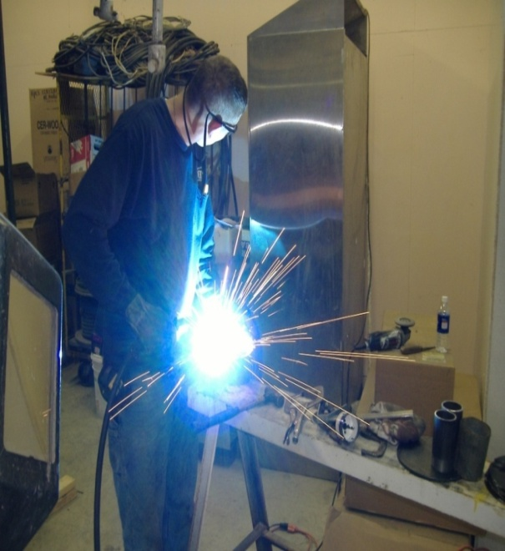
Potential Community Benefits
Educational and Employment opportunities for Arkansas
Support of regional timber and mining Industry by exploring new markets for byproducts and products; including green credit study
Support of the regional economy through: Industry, R&D and job creation
Provide full service water and soils lab at NRRC to support community and industry

Slide 4
Projects
Transformative Energy Projects
Biomass (forestry products & animal waste) to energy gasification project
Transformative farm/energy project
Pyrolysis renewables (primarily rubber materials) to energy
Off load energy to hi demand uses at Business Parks
Provide full service water and soils lab at
NRRC to support community and industry

Slide 5
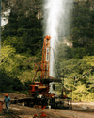
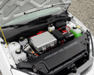
Potential Participants in the Energy Park and Learning Center
Natural Resource Research Center
NRRC
Biomass to Electric Generating Project
GeoThermal Technology
Waste to Energy Plants
Hydrogen Fuel Cells
SAU Science and
Engineering
Solar Panels

Slide 6
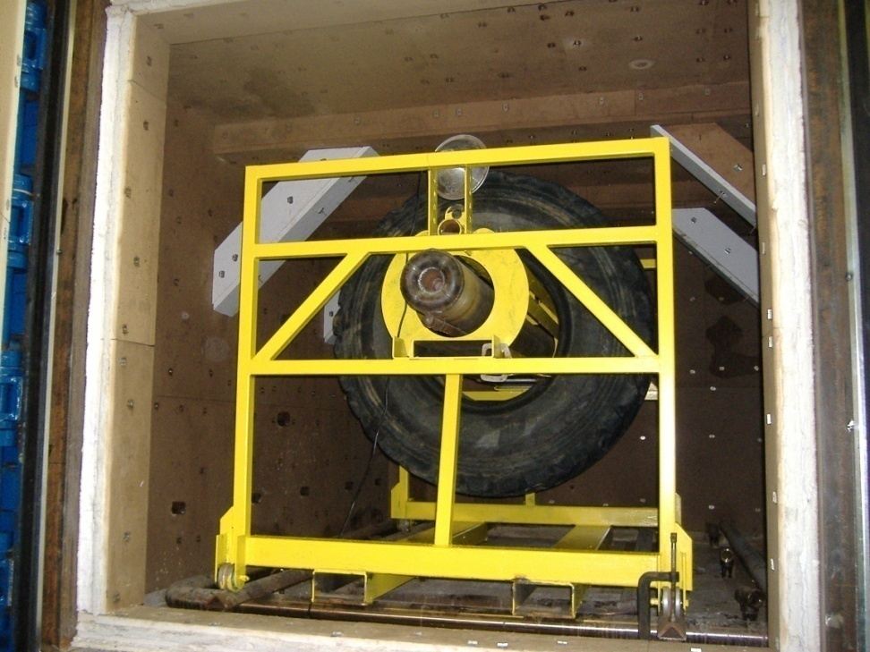
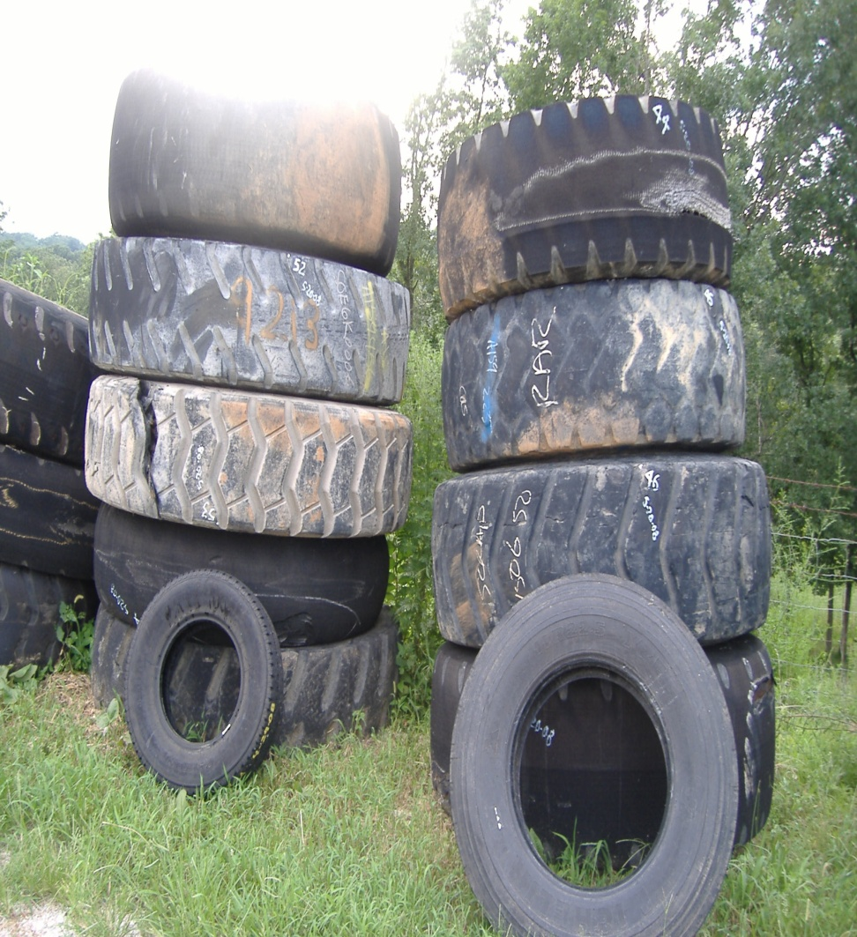
Converting plastics, tires, waste, oils into fuels suitable for use on forward operating bases 2007-2009, H. Buhr of HITEC LLC & S.E. McKay Awarded by LWI / US Army $1,300,000

Slide 7
Personnel & Expertise
Natural Resource Research Center (NRRC) - Personnel
Dr. Tim Schroeder, Director NRRC Assistant Professor of Chemistry, SAU Analytical Chemistry, NRCC Chemical Analysis and Characterization, Quality Control tsschroeder@saumag.edu
Ph: 870-235-4277 Experience: analytical chemistry and method development
Dr. Scott McKay College of Science Dean and Professor of Chemistry, SAU Research Scientist, chemistry/geologist, NRRC Alternative Energy & Fuels, and Petroleum projects semckay@saumag.edu ph: 870-235-4290 Experience: industry liaison, petroleum research, alternative energy
Dr. Richard Rogers Assistant Professor of Physics/Engineering Research Scientist, Engineering, NRRC rrogers@saumag.edu
Ph: 870-235-4294 Experience: civil and structural engineering
Mr. Robert W. Lashlee, III Research Analyst, Physicist
Computational Systems and Modeling

